Slide 1

Heredity and Evolution
Mendel’s Monohybrid cross

Slide 2
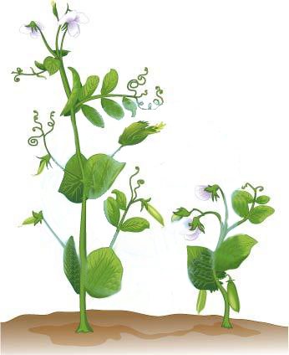
Mendel’s Monohybrid cross
He symbolise tall pea plant as TT and dwarf pea plant as tt
Mendel crossed tall pea plant and dwarf pea plant
Parents (P1)
T T
t t
Tall pea plant
Dwarf pea plant
Gametes
T
T
T
T
t
t
t
t
t
T
t
T
T
F1 generation
First filial generation
Mendel observed that all the plants were tall as ‘T’ is dominant over ‘t’

Slide 3


Mendel’s Monohybrid cross
Mendel self crossed the two tall plants of F1 generation
Parents (P2)
T t
T t
Mendel observed there are three tall plants
Gametes
T
t
and one dwarf plant
t
T
T
t
T
t
T
F2 generation
TT
Tt
Second filial generation
As ‘t’ and ‘t’ both are recessive
Tt
tt
As ‘T’ is dominant over ‘t’

Slide 4
Mendel’s Monohybrid cross
Mendel concluded his results of monohybrid cross as
F2 generation
TT
Tt
Tt
tt
Ratio
Tall
Tall
Tall
Dwarf
Phenotypic ratio
3 Tall
1 Dwarf
3:1
Genotypic ratio
TT
Tt
Tt
tt
Ratio
Appearance
Genes
1:2:1
1
2
1

Slide 5
Thank You

